Slide 1
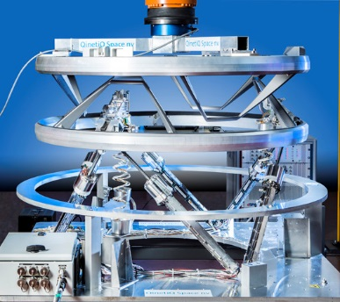
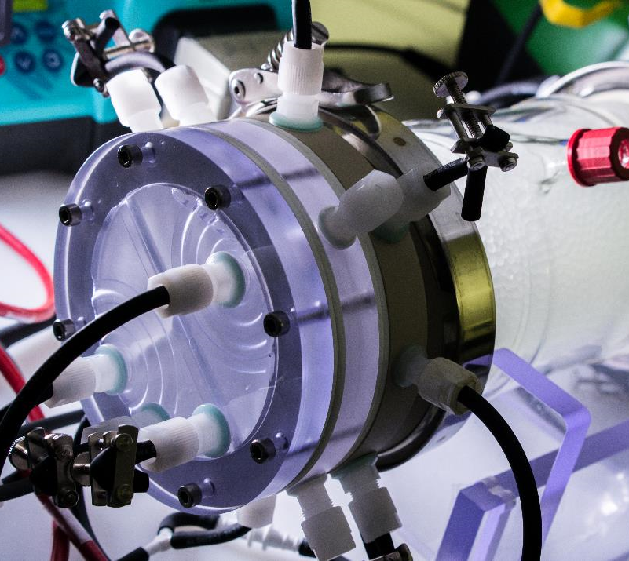
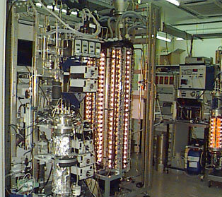
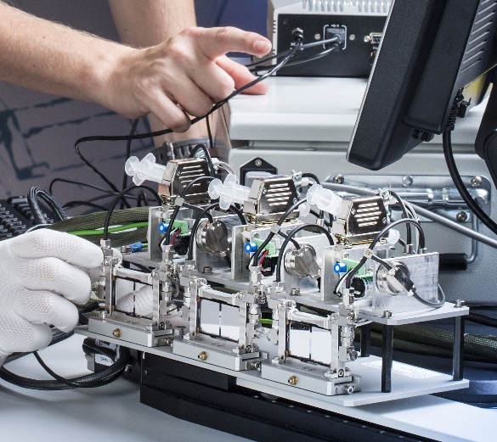
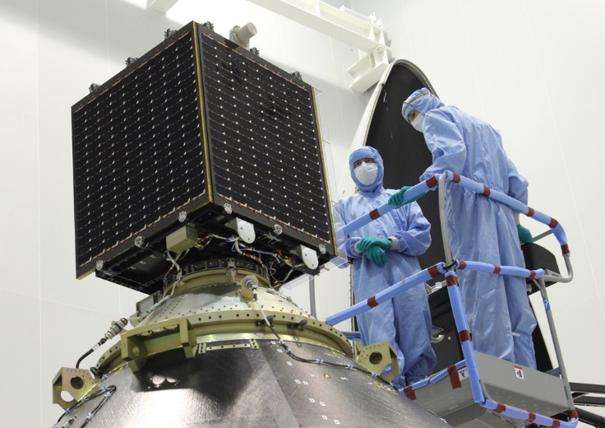
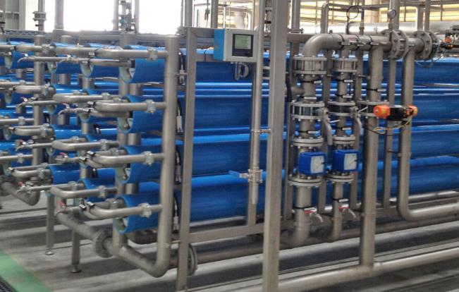
Synergetic Interactions between Space and Process Engineering
Subtitle
Source:euwa.com
May 2018 - Rome
Workshop - Current and Future Ways to Closed Life Support Systems

Slide 2
What means “Engineering” to You ?
Mechanics
Application
Physics
Genetics
Waste
Factory
Analysis
Energy
Electrical
Micro-organisms
Economics
Software
Process
Appliance
Equipment
Thermodynamics
Materials
Procedures
Report
Launchers
Life support
Product
Synthesis
Mathematics
Design
Measuring
Environment
Manufacturing
System
Resources
Engineering
Crops
Transport
Omics
Modelling
Microorganism
Technology
Supply chain
Method
Regulations
Construction
Laboratory
Cultivation
Maritime
Chemistry
Production
Architecture
Life science
Demonstration
Structures
Science
Aerospace
Safety
Hydrodynamics
Requirements
Develop
Plant
Control
Automation
Test
Ecology
Component
Discipline
Experiments
Quality
Nanotechnology
Kinetics
Documents
Aviation
Simulation
Biology
Factory

Slide 3









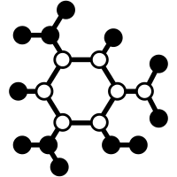

Space Systems Engineer
Chemical Process Engineer

Slide 4
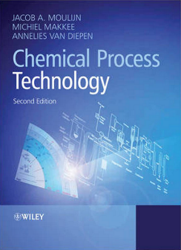
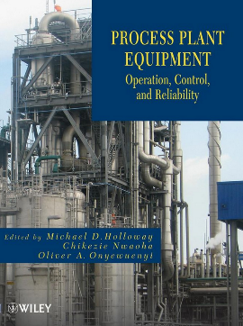
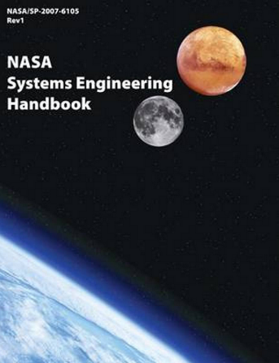
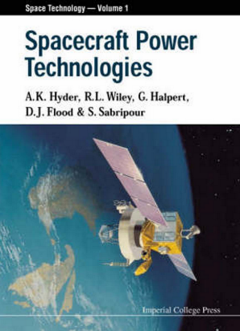
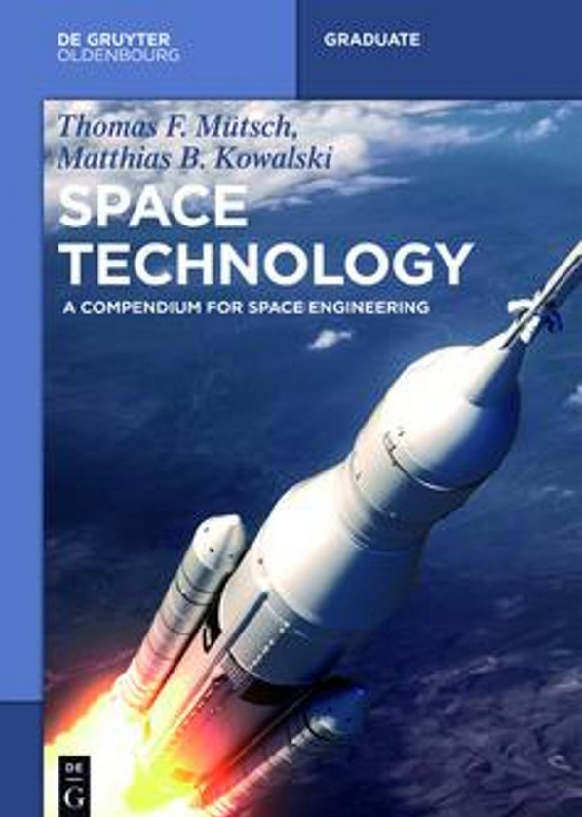

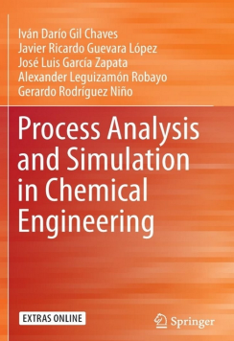
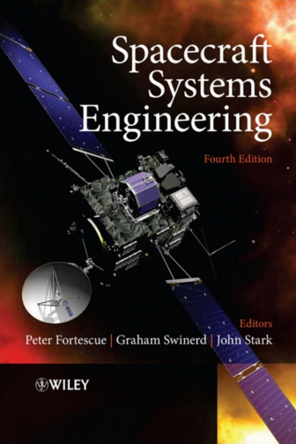
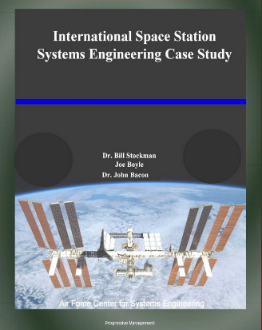
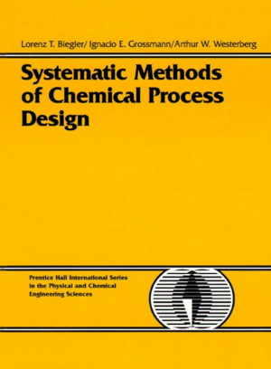
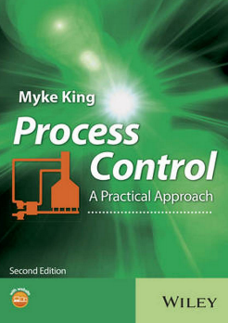
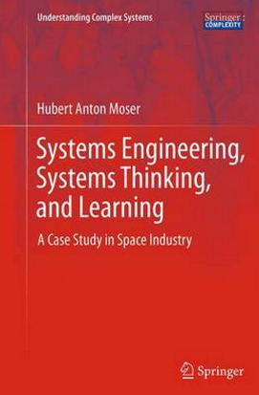
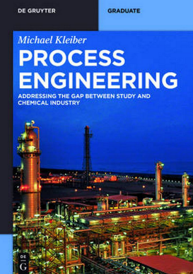
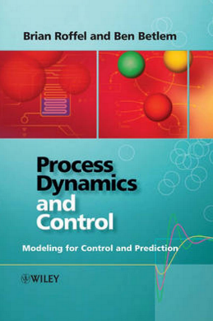
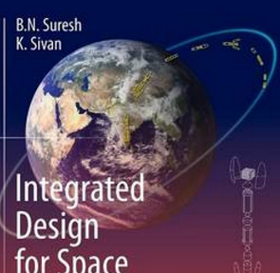
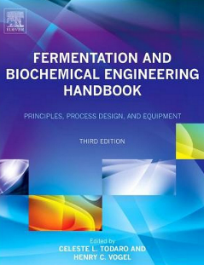
SYSTEM
SYSTEM
PROCESS
TECHNOLOGY

Slide 5
SYSTEM
PROCESS
?
TECHNOLOGY

Slide 6
SYSTEM
PROCESS
?
TECHNOLOGY

Slide 7
Chemistry
INPUT
OUTPUT
Biology
PROCESS
Transformation
Physics
What RESOURCES do i have/need ?
What PRODUCT do i want ?
Mechanics
Electronics
SYSTEM
Equipment
Software

Slide 8
Chemistry
INPUT
OUTPUT
Biology
TECHNOLOGY
Physics
What RESOURCES do i have/need ?
What PRODUCT do i want ?
Mechanics
Electronics
Equipment
Software

Slide 9
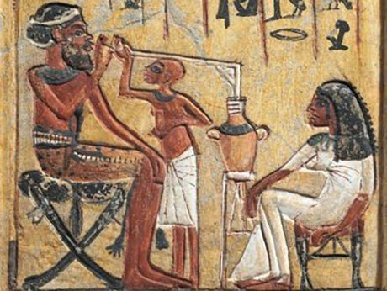
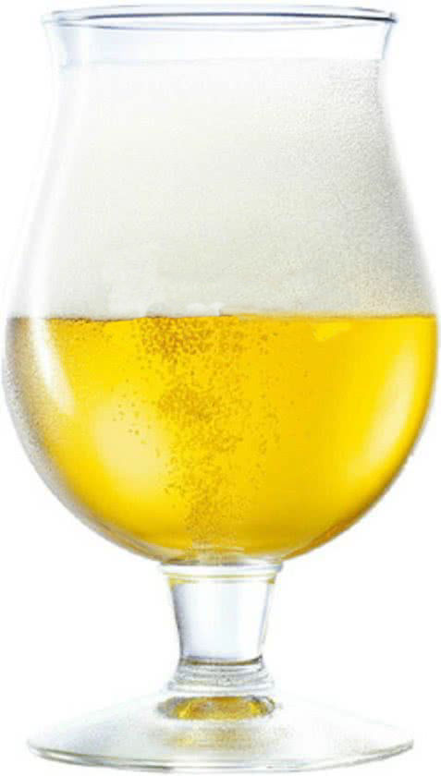
The most ancient known process ?

Slide 10
Beer Brewing
WATER
YEAST
MALT
HOP
BEER
Fermentation
BREWERY
Fermentors

Slide 11
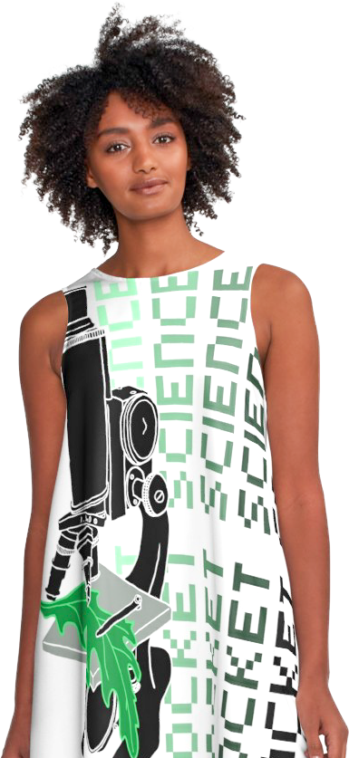
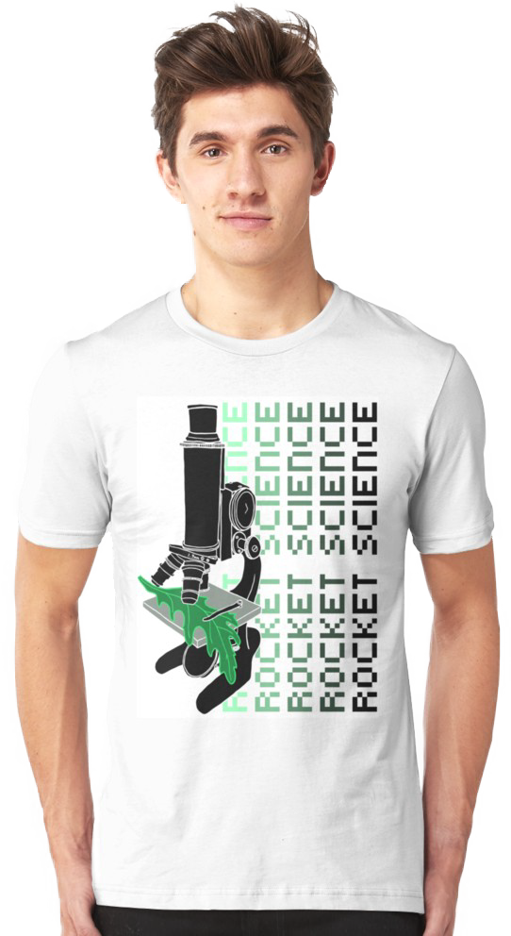
Life Support Technology
Mechanics
Application
Physics
Genetics
Waste
Fine ! But with the feeding pump at 40 % of maximum speed to prevent feed overload to the organisms
Factory
Electrical
Micro-organisms
Analysis
Energy
Let’s push the start button of our water treatment system !
Economics
Software
Processes
Appliance
Equipment
Thermodynamics
Materials
Procedures
Report
Launchers
Life Support
Product
Mathematics
Synthesis
Design
Measuring
Environment
Manufacturing
Systems
Resources
Engineering
Crops
Transport
Omics
Modelling
Microorganism
Technology
Supply chain
Method
Regulations
Construction
Laboratory
Cultivation
Maritime
Chemistry
Production
Architecture
Life science
Demonstration
Structures
Science
Aerospace
Safety
Hydrodynamics
Requirements
Develop
Plant
Control
Automation
Test
Ecology
Component
Discipline
Experiments
Quality
Nanotechnology
Kinetics
Documents
Aviation
Simulation
Biology
Factory

Slide 12
Project phases – Space Industry
Hybrid Model
Milestone Driven Program Management
Waterfall
Requirements
Engineering Production Verification
Operations

Slide 13
Project phases – Process industry
Agile
Interface Management
Hybrid - Waterfall
6Sigma
Needs
Process Solutions
System requirements
Research
Process
Engineering
System
Operations

Slide 14
Synergetic Interactions
Agile
Interface Management
Waterfall
Needs
Process Solutions
System requirements
Research
Process
Engineering
System
Operations

Slide 15
References
ECSS-E-AS-11C – Adoption Notice of ISO 16290, Space systems – Definition of the Technology Readiness Levels (TRLs) and their criteria of assessment (1 October 2014)
http://ecss.nl/standard/ecss-e-as-11c-adoption-notice-of-iso-16290-space-systems-definition-of-the-technology-readiness-levels-trls-and-their-criteria-of-assessment-1-october-2014/
http://my.chemeng.queensu.ca/courses/CHEE400/Tech.%20Eval1.pdf
https://www.altexsoft.com/whitepapers/agile-project-management-best-practices-and-methodologies/
https://www.redbubble.com – science shirts

